Slide 1
Presenter 1

Slide 2
Predicting Spotify Song Popularity
Group 6: Christy Hui, Cindy Shih, Kathleen Wu, Mary Velasquez, Ramiro Lobo
Notes:
Hello. Welcome to our presentation, which seeks to predict spotify song popularity based off of several factors curated by spotify.

Slide 3
Abstract
Our project aims to identify key factors influencing Spotify's popularity metric for individual songs. Through multiple linear regression, we identified several significant variables affecting popularity, such as genre, danceability, and tempo. However, a low R-squared value and evidence of heteroscedasticity suggest that alternative modeling approaches or additional data may be needed for a more accurate analysis.
Notes:
It turns out that, through multiple linear regression, there are several significant variables affecting popularity.
However, the results of our model are inconclusive, as there were a few roadblocks that make our model invalid.
These include a low R-squared value, the evidence of heteroscedasticity, and a non-normality of variables.
This suggests that alternative models may be needed for a more accurate analysis.

Slide 4
Data Source
10,000 Songs
Australia Spotify
Predictors
We sourced a collection of 10,000 of the most popular songs that have dominated the music scene from the 1950 to the present day.
The dataset was curated from Spotify based on rankings from both the Australian Recording Industry Association and billboard charts.
Each song has certain characteristics, which we used as predictors. We were particularly interested in genres, scores curated by Spotify, and release year.
Notes:
Let’s talk about the data.
We found a dataset from Kaggle that had 10,000 popular spotify songs, which was based off rankings in Australia.
Each song has certain characteristics, such as a level of danceability, a level of acousticness, and more. It also contained genres, whether or not the song was explicit, and the release year.

Slide 5
Research Questions
What factors determine Spotify’s popularity metric?
Do specific genres influence a song’s popularity?
Does a song’s explicitness affect the popularity of a song?
Which numerical variables affect song popularity the most?
Notes:
This leads us to our main research question: which factors determine a song’s popularity? Which factors are significant? Do specific genres influence a song’s popularity? So on and so on…

Slide 6
Categorical
(Genre/Explicit)
Popularity
Numerical
(Spotify Metrics)
Model Assumptions and Shortcomings
EDA
Model Selection
and Fine Tuning
Notes:
More specifically, our dataset includes the variables shown (and more). We decided to work on these variables specifically simply based off of interest.
The majority of the variables are scores (such “Danceability”, which measures how danceable a song is).
We were curious whether or not the score of these songs in each category could reliably predict a song’s popularity.
We were also curious about genre and explicit songs. Were pop songs more popular than non-pop songs? Are non-explicit songs more popular than explicit songs?
Outcome (Popularity)
Categorical (Genre/Explicit)
Numerical (Curated Spotify Scores)

Slide 7
Variable Specifics
Popularity (Numerical)
Explicit (Categorical, Binary)
Danceability (Numerical)
Energy (Numerical)
Key (Categorical)
Loudness (Numerical)
Mode (Categorical, Binary)
Speechiness (Numerical)
Acousticness (Numerical)
Instrumentalness (Numerical)
Liveness (Numerical)
Valence (Numerical)
Tempo (Numerical)
Time.Signature (Numerical)
Release.Year (Numerical)
genreSimplified (Categorical, 4 Levels)
Notes:
More specifically, our dataset includes the variables shown (and more). We decided to work on these variables specifically simply based off of interest.
The majority of the variables are scores (such “Danceability”, which measures how danceable a song is).
We were curious whether or not the score of these songs in each category could reliably predict a song’s popularity.
We were also curious about genre and explicit songs. Were pop songs more popular than non-pop songs? Are non-explicit songs more popular than explicit songs?

Slide 8
Presenter 2

Slide 9
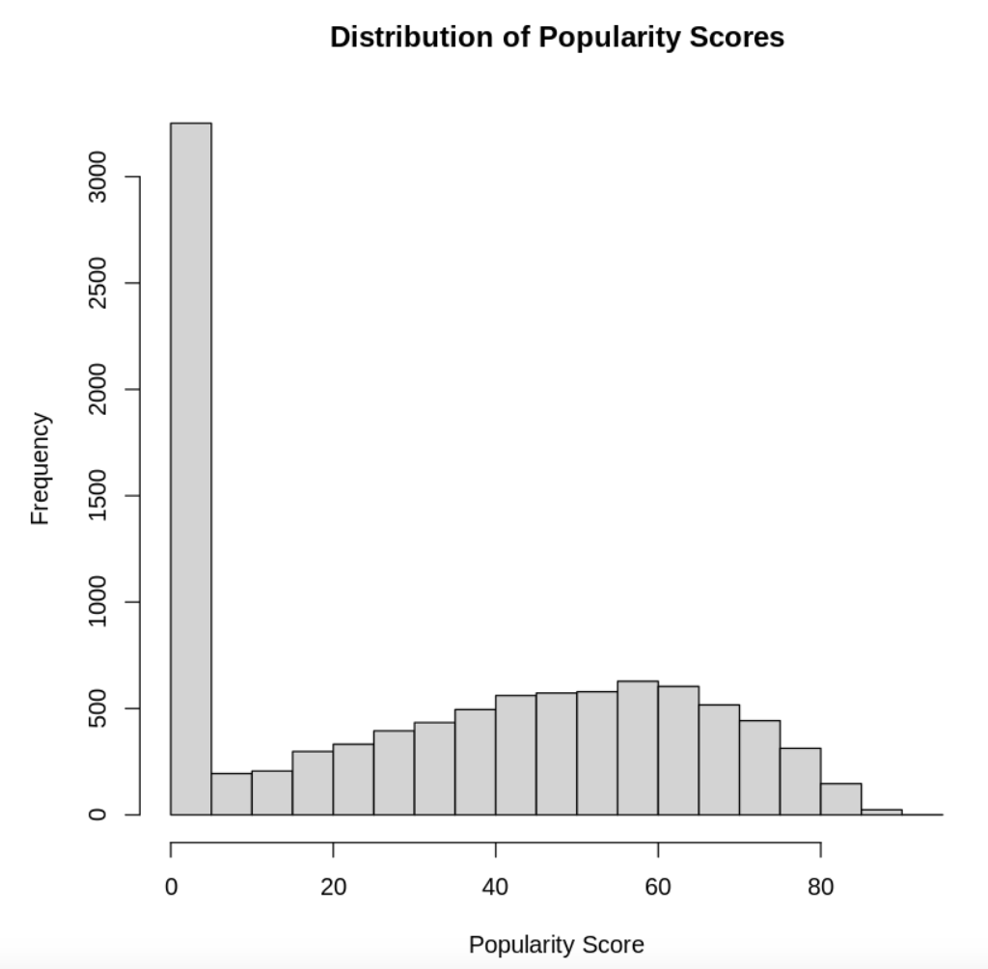
Data Cleaning - Popularity
Before cleaning, almost 30% of songs had a popularity score equal to zero. This will skew our data.
Notes:
Initially, we saw that the data wasn’t clean.
Shown here is a histogram of the popularity scores of the raw data set.
We can notice that the tall bar, on the left side, indicates a large amount of 0s.
Not only will these 0s violate normality, it doesn’t make sense to keep songs that have no popularity.

Slide 10
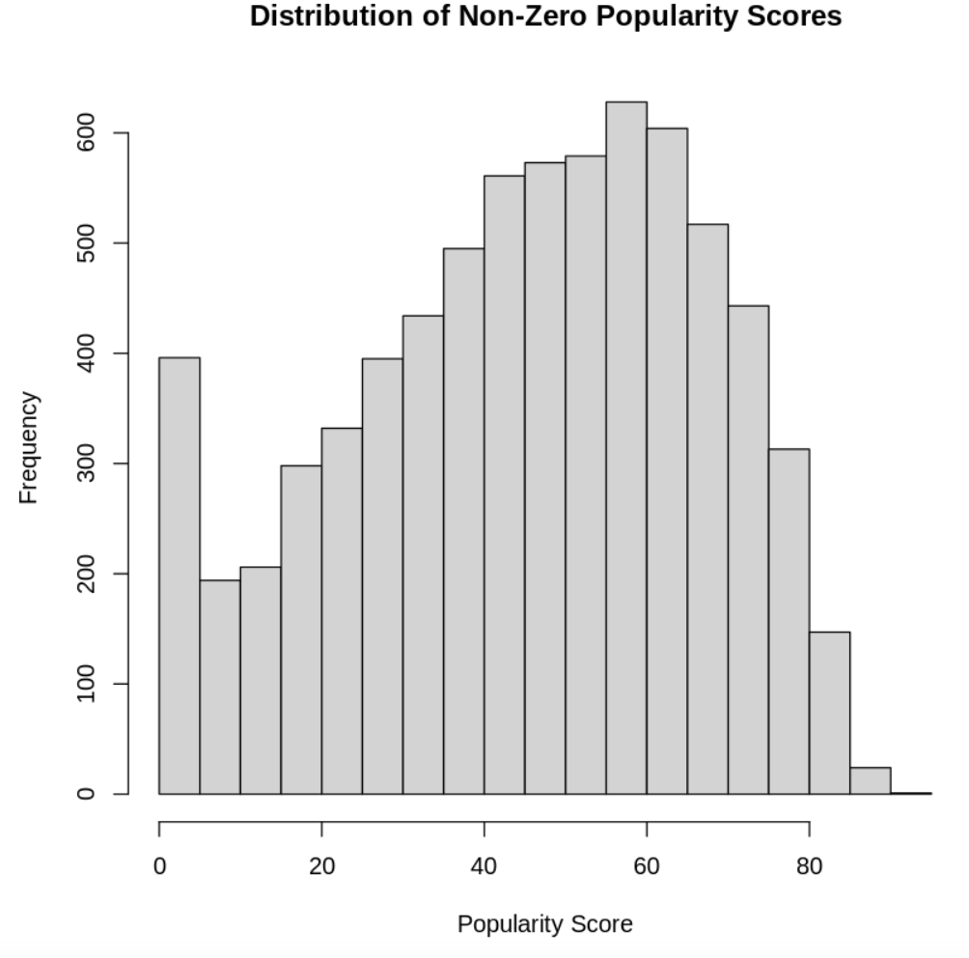
Data Cleaning - Popularity
After deleting songs with popularity scores of zero, we see our data is a bit more normally distributed.
Notes:
As such, we decided to delete the zeros, and after looking at the histogram, our data seems more normally distributed.
Note we are making an assumption here: the large amount of zeros is probably due to some error and is not representative of the population of songs, as there should not be this many songs with a score of zero considering they are supposed to all be “popular” songs from the 1950s till now.
It’s important to note that we did perform transformations (such as boxcox and log transformations) to Popularity; however, none of the transformations performed well.
IGNORE
There is basis for this assumption to be true: these songs are supposed to be “popular” songs from the 1950s until now. There shouldn’t be this many songs with a popularity of zero.
As shown in the histogram, after deleting zeros, our assumption of normality seems to be a bit better.

Slide 11
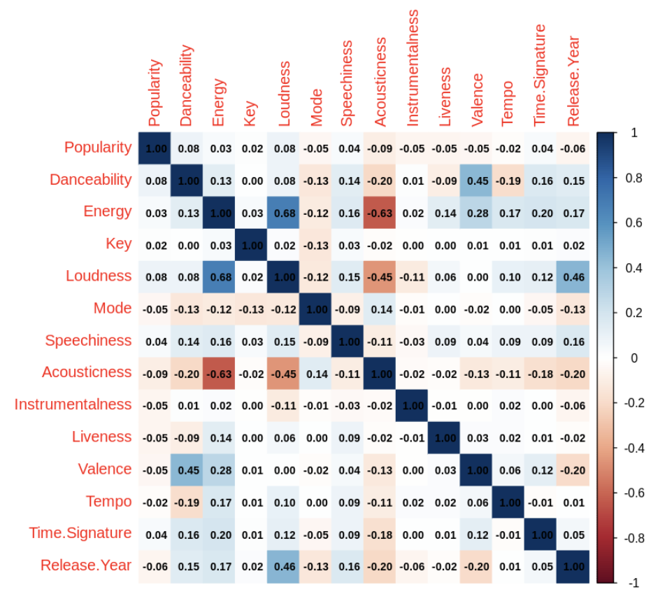
Correlation Matrix with Numeric Variables
A majority of the variables are not highly correlated except for a select few.
We expect Acousticness and Energy, Valence and Danceability, as well as Release Year and Loudness to have similar effects when put into the regression model.
Notes:
To observe our variables and further data better, we created a correlation matrix of our numerical variables.
a majority of variables are not highly correlated (and most are quite close to 0) but there are a select few (for instance: Acousticness and Energy, Valence Danceability, Release Yr and Loudness).
Since we have variables that are highly correlated with each other that aren’t highly correlated with many others, we decided to keep all numerical variables inside the model.

Slide 12
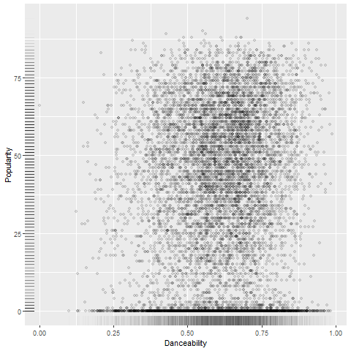
Scatter Plots - Numerical Variables vs Popularity
When creating scatter plots of our numerical predictors versus the popularity scores, there were no clear patterns
For example, when examining Danceability and Popularity there is no obvious relationship
Notes:
This slide (which displays a scatterplot of Danceability vs Popularity) shows an example of what we saw for our numerical variables plotted against the popularity variable, mainly a cluster of points with no discernable trends.
This may mean that this data is randomly distributed. However, this pattern may indicate that our regression model might have trouble using the numerical predictors to predict the Popularity variable later.
IGNORE
After creating scatterplots of our variables, It is also important to note that all scatter plot of our numerical predictors showed no clear patterns.

Slide 13
Presenter 3

Slide 14
Creating a New Genre Variable
Initially, the data contained over 900 different genres
To ease interpretation and analysis we created four categories
Pop
Rock
Both Pop and Rock
Other
Genre | Count
Pop | 2,896
Rock | 1,646
Pop + Rock | 1,178
Other | 1,420
Notes:
Let’s talk about categorical variables.
We wanted to explore whether specific genres influence a song’s popularity
Initially, the Genre variable consisted of a list of genres (not just one) an artist makes songs for.
As such, to ease interpretation and analysis, we decided to create a new variable which split the genre variable into 4 main categories: pop, rock, both pop and rock, and songs that didn’t have either.
The table on the right includes the count of each category. With the exception of pop, our numbers seem to be quite close together.

Slide 15
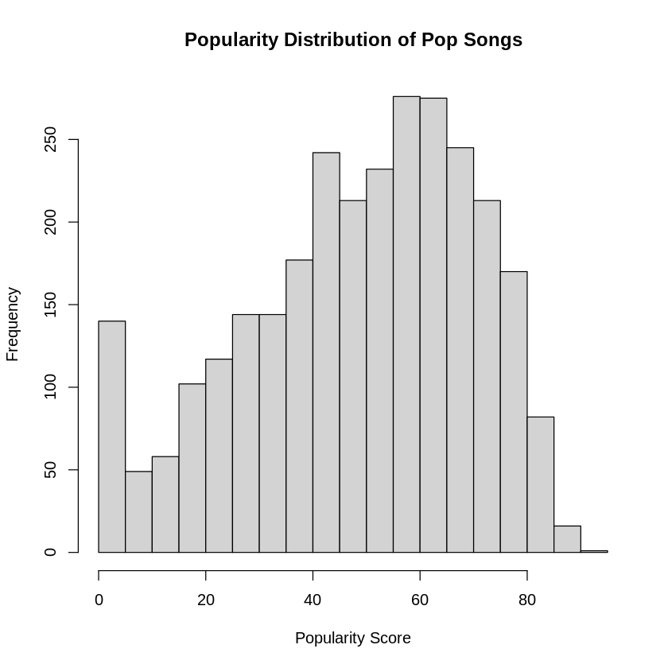
EDA: Histograms Exploring Genre and Popularity
The popularity of pop songs seem to be a bit left skew.
Other levels were also left skew
Means:
Pop: 48.91
Rock: 46.99
Both: 46.24
Notes:
This slide shows the distribution of popularity for our pop songs. The popularity of pop songs seem to be a bit left skew.
In context, this means that pop songs tend to be more popular than not popular.
We saw this trend for all levels except for the Other category, which was more right skewed

Slide 16
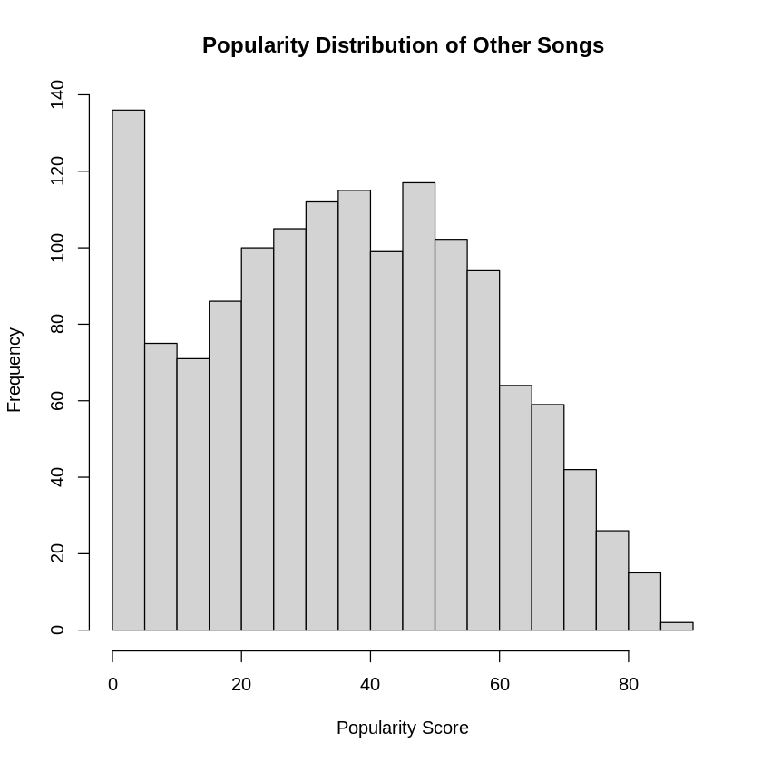
EDA: Histograms Exploring Genre and Popularity
The popularity of non pop and non rock songs are right skew
Songs with a prevalence of pop or rock are, on average, more popular than songs that are not.
Mean of Other Songs: 36.55
Notes:
In context, this meant that the prevalence of pop or rock in songs tend to be more popular than songs that do not.
This difference is promising and the variable may be meaningful if our regression model can reliably capture the difference in popularity between pop/rock and non-pop/rock songs.

Slide 17
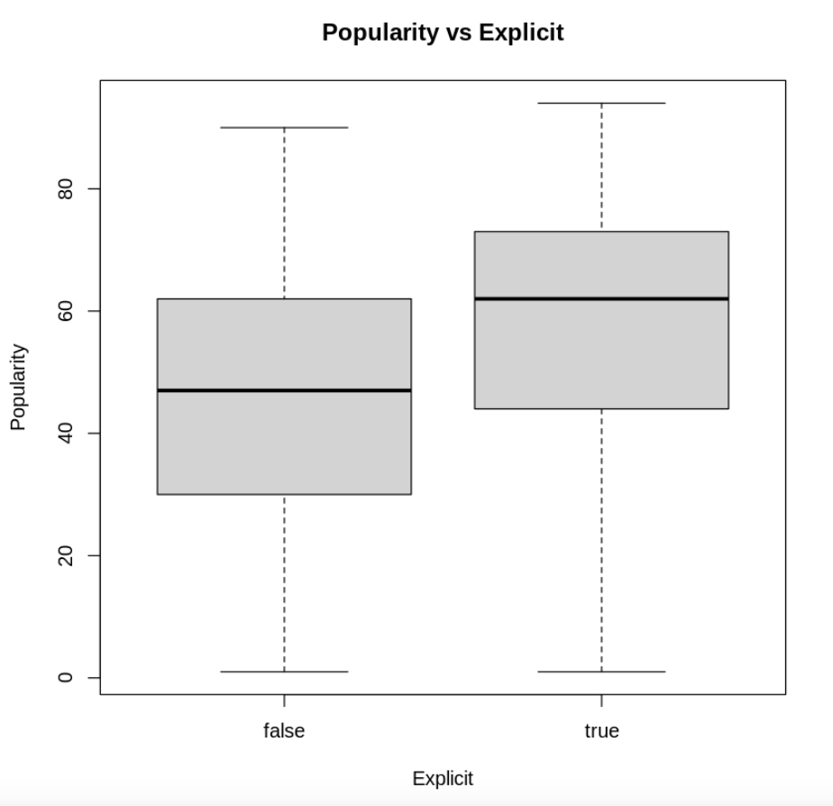
Exploring Explicit and Popularity
The spread of each explicit group per popularity score are quite different
This may be due to the large difference in counts between explicit and non-explicit songs
Explicit | Count
False | 6,764
True | 376
Notes:
In addition to genre, we wanted to explore the explicit variable, the explicit variable is binary: the song is explicit (True) or not (False).
On the left, we have a boxplot of popularity scores for each explicit category.
In context, this boxplot shows that: on average, explicit songs score higher in popularity.
Note this difference is most likely due to the large difference in the number of explicit and non explicit songs in our dataset.

Slide 18
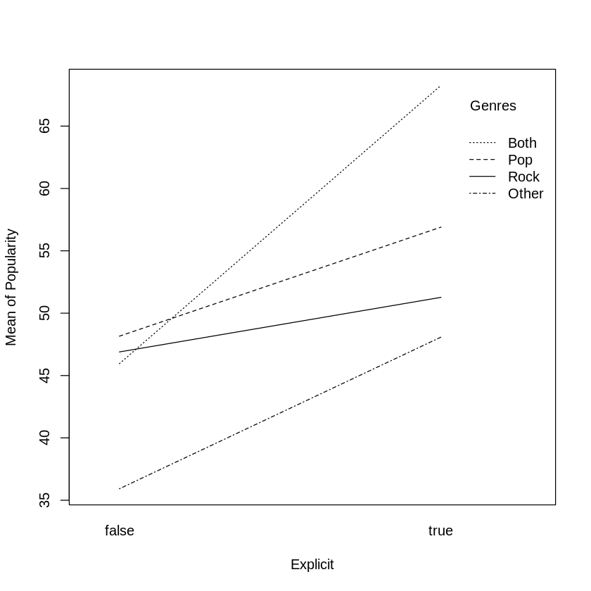
Interaction effect
From our interaction plot and ANOVA output below, we have reason to believe these two categorical variables are connected
Variable | ANOVA P-Value
Explicit | > 0.001 (Significant)
Genre | > 0.001 (Significant)
Explicit*Genre | 0.0286 (Significant)
Notes:
Specifically, we were curious about how our categorical variables interact. The interaction plot on the left shows the averages for explicit songs for each genre are always higher than their counterpart. It also shows disordinal interaction between all of our categories, suggesting that our variables interact closely.
Due to the interaction, we should be cautious with interpreting the main effects independently, as they might not hold consistently across all levels of the interacting variables.
Note we also performed an ANOVA with interaction effects, which we have reason to believe that the interaction effect between explicit and genre is significant.

Slide 19
RAMIRO

Slide 20
Model Selection
Model 1 | All variables with main effects
Model 2 | All main effects and interaction terms
Model 3 | All main effects and significant interaction terms
Notes:
After performing EDA, we proceed with modeling to answer our original question: which key factors influence Spotify's popularity metric for individual song?
We decided to create three models:
One model with all main effects.
One model with all main effects and all two factor interaction terms
And one model that uses all main effects and the significant two-factor interaction terms.
Despite our results from the ANOVA and interaction plots, we still decided to keep the main effects of the categorical variables because we were simply curious if these variables were significant.

Slide 21
Model 1: Only Main Effects (Sample Output)
Variable | Coefficient | P-Value
Explicit (True) | 8.39465 | Significant
Genre (Both) | 9.18144 | Significant
Danceability | 20.18147 | Significant
Key | 0.14366 | Not Significant
Acousticness | -6.24830 | Significant
Instrumentalness | -4.50231 | Significant
Valence | -10.32126 | Significant
Tempo | 0.01634 | Not Significant
Release Year | -0.28514 | Significant
Most predictors are significant at the 5% level.
Only a select few variables were insignificant.
Example interpretation:
On average, as danceability increases by one unit, popularity increases by over 20 units
Notes:
This slide shows a few predictors from our model and the results.
Although not all of our predictors were shown, a majority of our predictors are significant with a p-value less than 0.05.
However, a few were not significant, such as Key and Tempo.
Notice that although Explicit and Genre are significant, it does not make sense to interpret them the same way as if they are independent, as an interaction effect exists.
However, it does make sense to interpret our numerical variables; for instance, on average, as danceability increases by one unit, popularity increases by around 20.18 units.

Slide 22
Model 2: Interaction Effects (Sample Output)
Variable | Coefficient | P-Value
Explicit (True) | -991.8 | Significant
Genre (Both) | -319.4 | Significant
Danceability | -184.7 | Not Significant
Key | 1.674 | Not Significant
Loudness | -47.79 | Significant
Tempo | -0.8479 | Not Significant
Explicit * Genre (Pop) | 10.54 | Not Significant
Explicit * Genre (Rock) | -4.749 | Not Significant
Explicit * Genre (Both) | -1.987 | Not Significant
Most predictors become insignificant once we add many interaction effects.
Interaction effects are not significant despite the categorical variables themselves being significant.
In context, the interaction between our categorical variables may be insignificant, but the variables themselves are.
Notes:
Like the previous slide, this slide shows selected predictors from our model with interaction effects included. As we can see, introducing interaction terms has changed the significance of some predictors.
Many predictors that were significant in the first model (without interaction terms) are now insignificant. For instance, Danceability, which was significant previously, is now not significant.
This could be due to adding multiple interaction terms, which often increases model complexity and can impact the significance of individual predictors.
The coefficients represent the direction and magnitude of each predictor's effect on popularity. A negative coefficient, like -991.8 for Explicit (True), suggests that explicit songs are associated with a large decrease in popularity. However, since many coefficients we see are not significant, we should interpret only the significant ones cautiously and recognize that they might still be affected by interactions.
In this context, Explicit (True) and Genre (Both) are significant, indicating that explicit songs and songs in the 'Both' genre have a substantial impact on popularity.
Interestingly, none of the interaction effects between Explicit and Genre (e.g., Explicit * Genre (Pop)) are significant, even though the main effects of Explicit and Genre are. This suggests that while Explicit and Genre independently affect popularity, their combined effect does not add additional predictive value in this model.
(*not sure if true, nonlinear relationships as well as a lot of variability within combinations of Explicit and Genre categories can obscure effects, we see that the model may lack power to produce significant interaction term )
Even though the interaction terms are not statistically significant, there may still be a visual crossover interaction, as noted in the previous slide. This means that while we observe some differences in the trends across genres and explicit content, these differences aren't strong enough to be deemed statistically significant.

Slide 23
Model 3: Main Effects and Significant Interaction (Sample Output)
Variable | Coefficient | P-Value
Explicit (True) | -959.4 | Significant
Genre (Pop) | -539.9 | Significant
Loudness | -50.48 | Significant
Speechiness | 5.142 | Not Significant
Acousticness | -2.213 | Not Significant
Instrumentalness | -15.29 | Not Significant
Explicit*Genre (Pop) | 13.31 | Not Significant
Explicit*Genre (Rock) | -4.97 | Not Significant
Explicit*Genre (Both) | 2.211 | Not Significant
Even though model 3 is a simpler version of model 2, many variables become insignificant due to the introduction of interaction effects.
The interaction effects stay insignificant while the categorical variables themselves are significant.
Notes:
The results from model 3 are even less interesting.
We largely see the same patterns from model 2: many variables that were considered significant in model 1 become insignificant in model 2.
The interaction effects also stay insignificant while the categorical variables themselves are significant.

Slide 24
Model Selection - Results
Model | R-Squared Adjusted | RMSE | MAE | AIC
Model 1 | 0.0971 | 20.762 | 16.922 | 50739.4
Model 2 | 0.1204 | 20.855 | 16.934 | 50757.48
Model 3 | 0.1168 | 20.717 | 16.894 | 50656.58
Model 2 has the highest R-Squared adjusted.
Model 3 has the lowest errors for RMSE and MAE.
Model 3 has the lowest AIC score.
Notes:
After running the models, this table shows the results of each model’s performance: the R-squared, the errors when trying to predict on testing data, and the AIC.
First, we focus on the R-squared adjusted. For model 1, 9.71% of the variability in song popularity can be explained by the main effects. For model 2, 12.04% of the variability in song popularity can be explained by the predictors in model 2. And so on for model 3.
Notice how model 2 has the largest R-squared adjusted value; however the change isn’t extremely drastic when we take into account the amount of predictors that were added in the model, which increases R-squared.
When we take into account practicalness, this change in R-squared is insignificant, since we had to add so many predictors into the model.
RMSE and MSE assess accuracy of our model on the test results. The smaller the error, the better.
Notice how there isn’t a significant change between our errors; in fact, the simplest model with just the main effects (model 1) did better than the more complicated model (model 2) for both errors.
Model 3 performed only slightly better than model 1.
Finally, the AIC score, which helps assess overall performance, is extremely similar for all 3 models as well.
Model 3 performs the best in terms of AIC.
This means that model 3 explains more variation in popularity with a smaller emphasis on the independent variables.
The main takeaway is that, generally, our models are similar. However, practically, model 1 is the simplest. So although one can make an argument for performance for model 3, when we take into account complexity and practicality, model 1 is the best.
As such, we choose model 1, our simplest model to be our final model.

Slide 25
Final Model
Popularity =
599.6 + 8.394*(Explicit = True) + 20.2*Danceability
- 7.5*Energy + 0.1*Key + -0.6*Mode + 5.4*Speechiness
- 6.2*Acousticness - 4.5*Instrumentalness -5.3*Liveness - 10.3*Valence + 0.02*Tempo + 3.08*Time Signature- 0.3*Release Year + 9.2*(Genre=Both) + 11.6*(Genre=Pop) +8.9*(Genre=Rock)

Slide 26
Mary

Slide 27
Cross Validation - Results
Model | R-Squared | RMSE | MAE
LOOCV | 0.0991 | 20.5419 | 16.8049
5-Fold CV | 0.1006 | 20.5358 | 16.8026
10-Fold CV | 0.1010 | 20.53695 | 16.8028
LOOCV: Leave-One-Out Cross-Validation
5 Fold: Cross-Validated (5 fold, repeated 3 times)
10 Fold: Cross-Validated (10 fold, repeated 3 times)
Notes:
We also decided to perform cross validation to see whether different validation approaches could improve the performance metrics of our model, such as R-squared, RMSE, and MAE.
Unfortunately, cross validation only barely improved in R-squared and error metrics (RMSE and MAE), as shown.
Taking in the bigger picture, we are performing a complicated task only to yield similar results.
This lack of significant improvement suggests that our model’s predictive capacity is limited by the data or the model itself, rather than the validation method. Even if we optimized the fold-lambda pair or used more complex cross-validation strategies, we likely wouldn’t see substantial gains in performance.
This is all to say that our first model is the best model to choose from when we take into account practical and statistical significance.

Slide 28
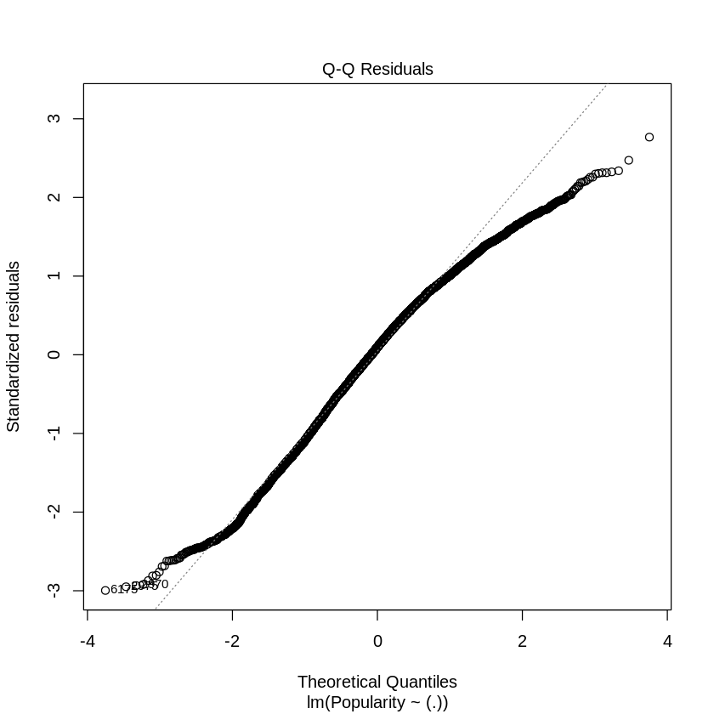
Model Assumptions - QQ plot
Upon inspection, the assumption of normality for our residuals looks fairly reasonable. Although the tails show a worrying trend, the residuals largely follow the trend line quite closely
Notes:
Since we have chosen our final model, we need to test a few assumptions.
According to the QQ plot shown in this slide, our assumption of normality of residuals is fairly reasonable.
Although some statisticians may say the tails show a worrying trend, this may honestly be as good as it gets for us.

Slide 29
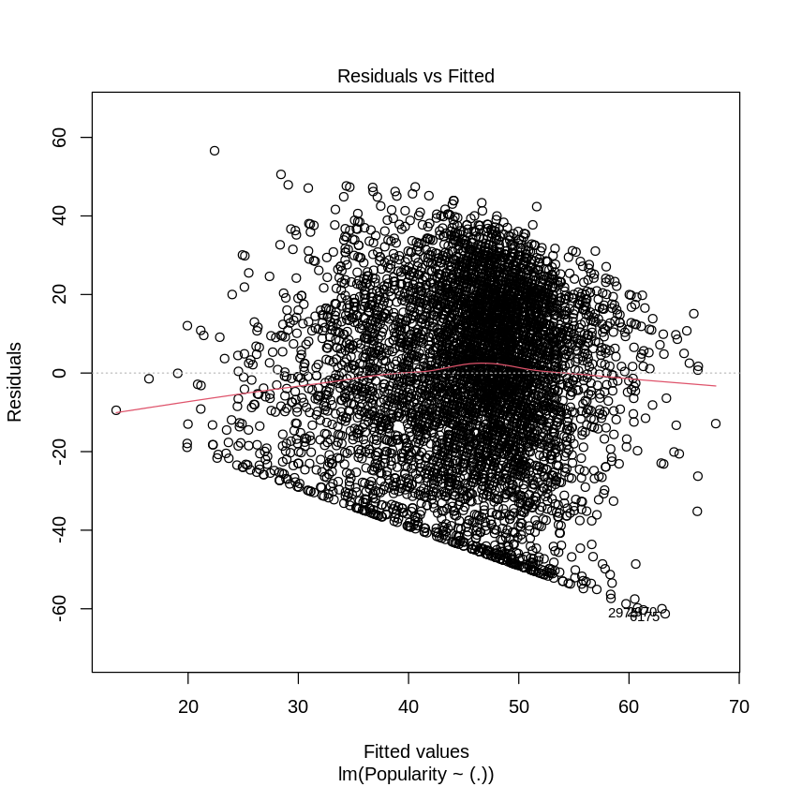
Model Assumptions - Residual Plot
Heteroscedasticity is present in our data according to the residuals vs. fitted plot.
When a Breusch Pagan test is ran, we get a p-value of 0.0391.
These two results indicate the homoscedasticity assumption is failed.
Notes:
Regression also has an assumption of heteroscedasticity.
Unfortunately, according to our Residuals vs. Fitted plot, homoscedasticity seems to fail.
Although the residuals seem to bounce around our reference line of x = 0, notice the weird limit that exists at the bottom of the cluster.
There seems to be some sort of artificial limit that makes our residuals not able to bounce under that limit.
Furthermore, when we run a non constant variance test in R, we get a p-value that is significant, although not by much.
So, we have reason to believe that heteroscedasticity is present in our model and that our assumption of non-constant variances fails.

Slide 30
Conclusion
Our data does not satisfy the assumptions required by OLS regression even after multiple transformations. This indicates there may be data that influence Spotify’s popularity metric that are not included in our data set or linear regression may not be the best method for this data.
In context, our original question is inconclusive: it seems as though popularity cannot be predicted using the data set we have with regression.
Notes:
In conclusion, our model is inconclusive.
We started with a dataset that needed to be cleaned and transformed. We wanted to use this dataset to see if the predictors in the dataset can be used to predict song popularity.
After transforming, we tested a few assumptions and had some thoughts that regression would fail. Nonetheless, for the purposes of this project, we decided to continue with regression and see how it would perform.
After testing a few models, we landed on the simplest one being the best one. However, because assumptions are failed, we cannot conclude anything.
In other words, given what we have in the dataset, using regression to predict Spotify song popularity may prove to be difficult (maybe impossible because our regression model fails assumptions needed for regression).
Note this does not mean that song popularity cannot be predicted. Other models such as Random Forest may perform better and even be able to reliably predict the song popularity given the dataset we have.

Slide 31
Shortcomings & Recommendation for Improvement
Shortcomings
Our model does not meet the assumption of equality of variance, and assumption of normality.
The popularity variable had many low scores, despite being top Australian songs.
Recommendations
Consider non-linear models such as decision trees and random forests.
It may be better to use a different metric like number of streams as a proxy for popularity
Notes:
Some shortcomings we found while working on the project:
Our model did not meet the assumptions required for regression
The popularity variable had many low scores. Not only were there many 0s, there were many 1s and 2s.
In the future, we recommend:
Non-linear models such as decision trees and random forests.
Also, using a different metric like number of streams as a proxy for popularity

Slide 32
THANK YOU!

